Slide 1
Principle of Mathematical Induction
Shreyas M
B.Tech in ECE PES University Bangalore

Slide 2
Chapter Map
Section | Topic
1 | Underlying concept
2 | Algorithmic approach
3 | Illustration

Slide 3
1 Underlying Concepts
Assume a series of tiles or domino blocks arranged in chain.
Our goal is to know if the chain falls completely
For doing so, we need to verify only 2 things.
The first one can fall.
If one falls, the next one will fall.
This is called ‘Domino Effect’ or ‘Motivation’
In mathematics, this is known as ‘Induction’ i.e. We ‘INDUCE’ each step of verification based on the previous one.

Slide 4
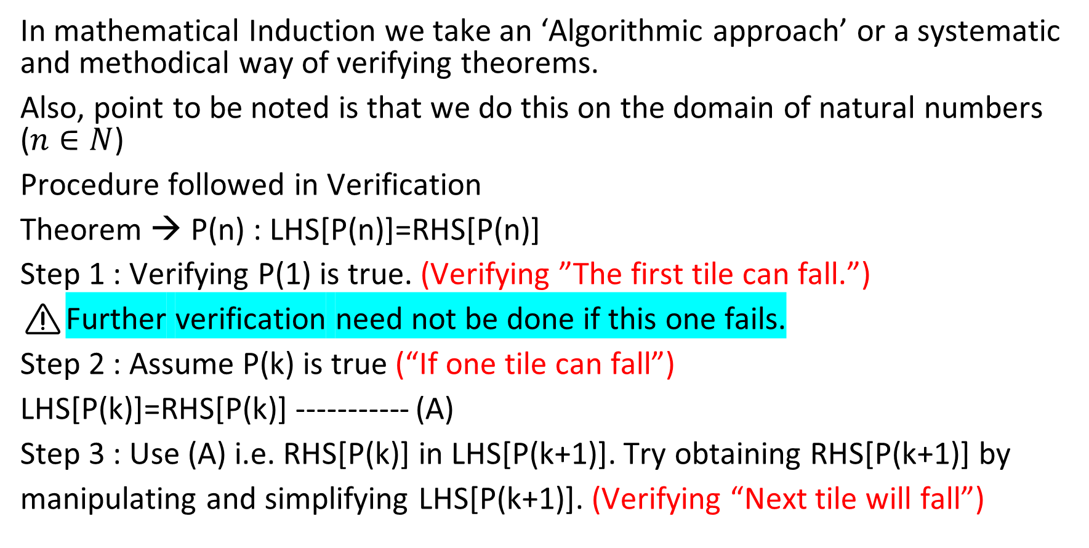
2 Algorithmic approach
In mathematical Induction we take an ‘Algorithmic approach’ or a systematic and methodical way of verifying theorems.
Also, point to be noted is that we do this on the domain of natural numbers ($n∈N$)
Procedure followed in Verification
Theorem → P(n) : LHS[P(n)]=RHS[P(n)]
Step 1 : Verifying P(1) is true. (Verifying ”The first tile can fall.”)
⚠️Further verification need not be done if this one fails.
Step 2 : Assume P(k) is true (“If one tile can fall”)
LHS[P(k)]=RHS[P(k)] ----------- (A)
Step 3 : Use (A) i.e. RHS[P(k)] in LHS[P(k+1)]. Try obtaining RHS[P(k+1)] by
manipulating and simplifying LHS[P(k+1)]. (Verifying “Next tile will fall”)

Slide 5
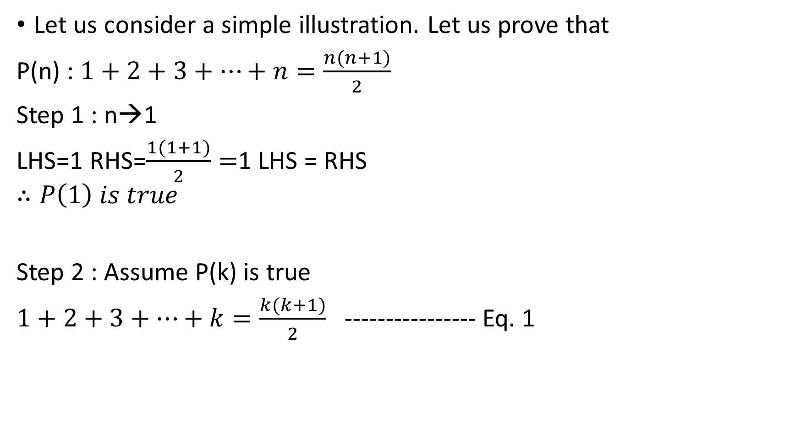
3 Illustration
Let us consider a simple illustration. Let us prove that
P(n) : $1+2+3+…+n=\frac{n(n+1)}{2}$
Step 1 : n→1
LHS=1 RHS=$\frac{1(1+1)}{2}=$1 LHS = RHS
$$∴P\left(1\right) is true$$
Step 2 : Assume P(k) is true
$1+2+3+…+k=\frac{k(k+1)}{2}$ ---------------- Eq. 1

Slide 6
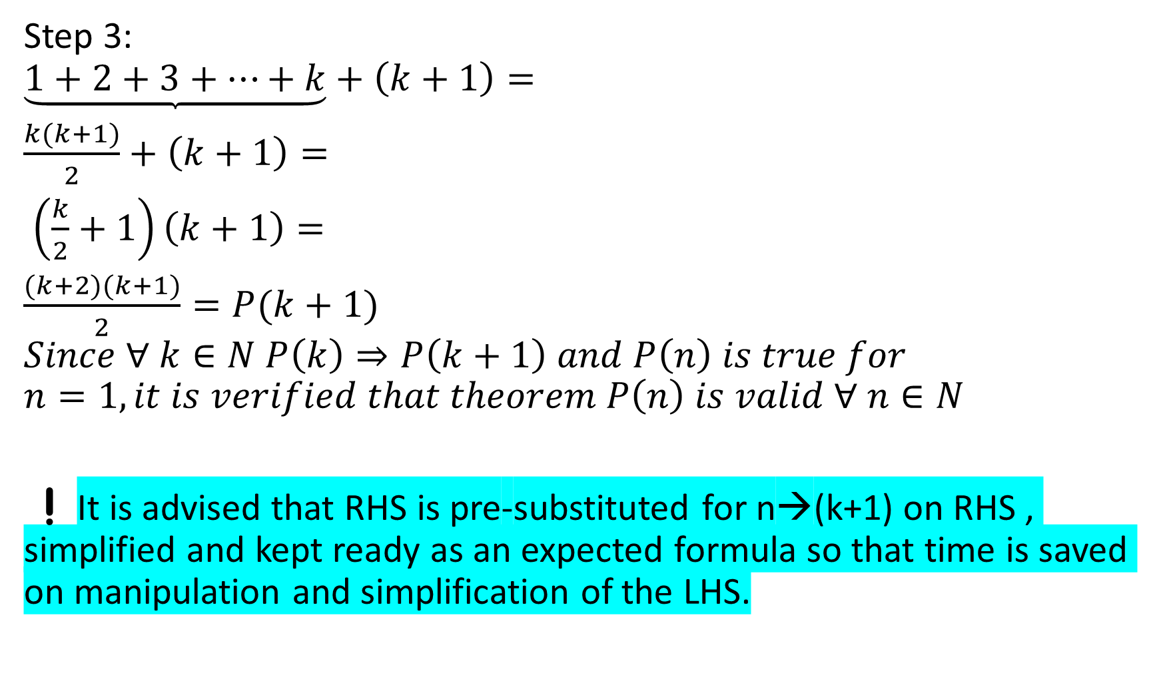
Step 3:
$$\underbrace{1+2+3+…+k}+\left(k+1\right)=$$
$\frac{k(k+1)}{2}+\left(k+1\right)=$
$\left(\frac{k}{2}+1\right)\left(k+1\right)=$
$\frac{(k+2)(k+1)}{2}=P(k+1)$
$$Since ∀ k∈N P\left(k\right)⇒P\left(k+1\right) and P\left(n\right) is true for$$
$$n=1, it is verified that theorem P\left(n\right) is valid ∀ n∈N$$
❗It is advised that RHS is pre-substituted for n→(k+1) on RHS , simplified and kept ready as an expected formula so that time is saved on manipulation and simplification of the LHS.

Slide 7
Thank you
Shreyas M
B.Tech in ECE PES University Bangalore

